Slide 1

Chapter 1
“Men will have a share of what they earn, and women will have a share of what they earn”. (4:32)
Labor Economics: Introduction and Overview

Slide 2
After reading this chapter, you should be able to:
LO 01-01: Explain why labor economics is justified as a special field of inquiry.
LO 01-02: Describe how the economic perspective can be applied to analysis of labor markets.
LO 01-03: Identify those topics in labor economics that are mainly “microeconomic” and those that are primarily “macroeconomic.
LO 01-04: Describe several benefits that derive from understanding labor economics.

Slide 3
1. Labor Economics as a Discipline

Slide 4
What is Labor Economics?
Labor is a factor of production that refers to the work people do to produce goods and services.
It includes all the physical and mental efforts that go into the production of goods and services.
The four types of labor in economics are skilled, unskilled, semi-skilled, and professional. Together, these four types of labor make up the active labor force.
The term labor market refers to employers buying labor services from workers in exchange for wages or other forms of compensation.
The labor market is determined by the supply of labor and the demand for labor

Slide 5
What is Labor Economics?
Most of us will allocate a substantial fraction of our time to the labor market.
How we do in the labor market helps determine our wealth, what we can afford to consume, with whom we associate, where we vacation, which schools our children attend, and even who finds us attractive.
Not surprisingly, we are all eager to learn how the labor market works.

Slide 6
What is Labor Economics?
Labor economics studies how labor markets work
Labor economics examines:
the organization, functioning, and outcomes of labor markets
the decisions of prospective and present labor market participants
public policies relating to the employment and payment of labor resources.

Slide 7
Some Policy Issues in Labor Economics?
Labor economics helps us understand and address many of the social and economic problems facing modern societies
Do welfare programs create work disincentives?
What is the impact of immigration on the wage of native-born workers?
Do minimum wages increase the unemployment rate of less-skilled workers?
What is the impact of occupational safety and health regulations on employment and earnings?
Do government subsidies of human capital investments improve the economic well-being of disadvantaged workers?

Slide 8
Policy Issues in Labor Economics?
Why did wage inequality in the United States rise so rapidly after 1980?
What is the impact of affirmative action programs on the earnings of women and minorities and on the number of women and minorities that firms hire?
What is the economic impact of unions, both on their members and on the rest of the economy?
Would merit pay for teachers improve the academic achievement of students?
Do generous unemployment insurance benefits lengthen the duration of spells of unemployment?

Slide 9
Actors in Labor Market
There are three leading actors in our story: workers, firms, and the government.
Workers will always act in ways that maximize their well-being.
Adding up the decisions of millions of workers generates the economy’s labor supply in terms of the number of persons seeking work, and also in terms of the quantity and quality of skills available to employers.
Persons who want to maximize their well-being tend to supply more time and more effort to those activities that have a higher payoff. The labor supply curve, therefore, is often upward sloping, as illustrated in Figure 1-1.

Slide 10
Actors in Labor Market
Each firm must decide how many and which types of workers to hire and fire, the length of the workweek, how much capital to employ, and whether to offer a safe or risky working environment to its workers.
Firms also have motives. We assume that firms want to maximize profits. The firm will maximize its profits by making the production decisions—and hence the hiring and firing decisions—that best serve the consumers’ needs.
In effect, the firm’s demand for labor is a derived demand, a demand derived from the desires of consumers.
Adding up the hiring and firing decisions of millions of employers generates the economy’s labor demand curve

Slide 11
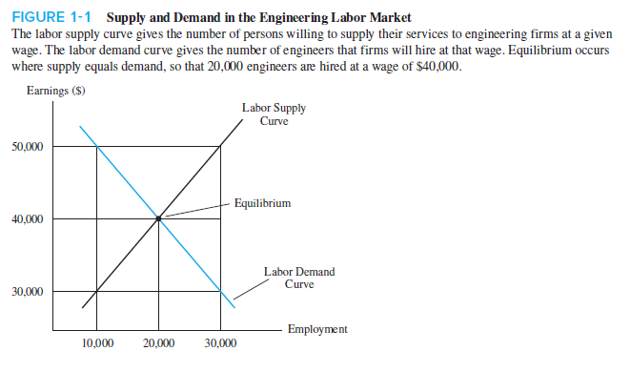
Actors in Labor Market

Slide 12
The Trans-Alaska Oil Pipeline-Case Study
In January 1968, oil was discovered in Prudhoe Bay in remote northern Alaska. The oil reserves were estimated to be greater than 10 billion barrels, making it the largest such discovery in North America.
There was one problem with the discovery—the oil was located in a remote and frigid area of Alaska, far from where most consumers lived. To solve the daunting problem of transporting the oil to those consumers who wanted to buy it, the oil companies proposed building a 48-inch pipeline across the 789-mile stretch from northern Alaska to the southern (and ice-free) port of Valdez. At Valdez, the oil would be transferred to oil supertankers.
Many of the workers employed by Alyeska and its subcontractors were engineers who had built pipelines across the world. Very few of those engineers were resident Alaskans. The remainder of the Alyeska workforce consisted of relatively low-skill labor such as truck drivers and excavators. Many of the low-skill workers were resident Alaskans

Slide 13
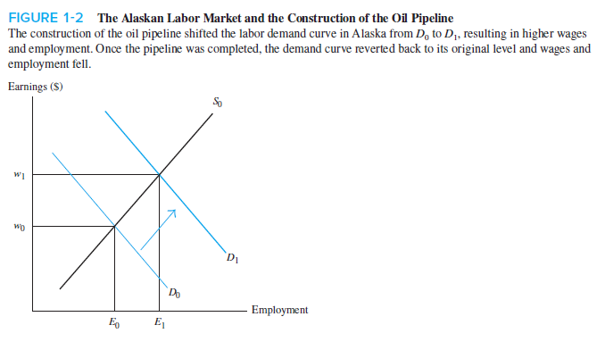
The Trans-Alaska Oil Pipeline-Case Study

Slide 14
Importance of Labor Economics
Socioeconomic Issues
Gender and race discrimination
Legal and illegal immigration
Fall in unionization
Free trade
We need simply glance at the newspaper headlines: “Senator calls for increase in minimum wage”; “General Motors cuts workforce”; “Labor productivity surges”; “Teamsters gain wage hike”; “Growing wage inequality”; “Jobless recovery”; “Free-trade agreement: Boon or bane for employment?”; “Workplace safety improves”; “Gender discrimination charged”; “More single parents in labor force”; “Illegal immigration continues”; “High executive salaries questioned”; “Jobs shipped out to foreigners.”
Quantitative Importance
70% of national income goes to labor.

Slide 15
Importance of Labor Economics
Unique Characteristics
Labor is rented and not bought/sold
Non-monetary aspects
Institutional factors
Unions, licensing, minimum wage, discrimination
Labor demand is a derived demand

Slide 16
2. The “Old” and the “New”

Slide 17
Change in Labor Economics
Old Approach
Highly descriptive and historical
Little economic analysis
New Approach
Uses applied micro and macro theory

Slide 18
3. Economic Perspective

Slide 19
Choice
Labor economics uses theories of choice to explain behavior of labor market participants and resulting outcomes. Theories rest on three assumptions…
1. Relative scarcity
2. Purposeful behavior
Choices involve giving something up -an opportunity cost.
Individuals make choices purposefully with an expected net gain.
3. Adaptability
Workers and firms adapt to changes in expected costs and benefits.

Slide 20

Choice

Slide 21
4. Overview

Slide 22
Overview
Microeconomics
Individual economic units or markets
Macroeconomics
Economy as a whole

Slide 23
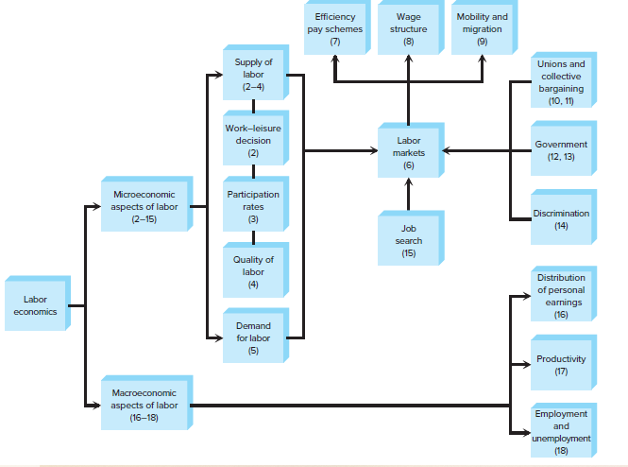
Overview

Slide 24
Questions for Thought
1. Why must the concepts of supply and demand as they pertain to products be modified when applied to labor markets?
2. Indicate whether each of the following statements pertains to microeconomics or macroeconomics:
(a) The unemployment rate in the United States was 5.3 percent in 2015.
(b) Bartenders at Andrew’s Capital Bar and Grill earn $9.25 per hour.
(c) The productivity of American workers as a whole has increased by more than 2 percent per year in the last 4 years.

Slide 25
Useful Learning Websites
Economist Magazine
Go to the website for the Economist magazine (http://www.economist.com). Locate and cite an entry that covers a labor economics issue.
The Nobel e-Museum website provides information about the Nobel Prize winners in economics.
(http://www.nobelprize.org/nobel_prizes/economic-sciences/)
The website for the Open Directory Project supplies many labor economics–related links.
(http://dmoz.org/Science/Social_Sciences/Economics/Labor_Economics)

